Slide 1
Data Modeling Concepts Part 2
<Data Model 101 Series>
Anand Kumar
Notes:
Hi. Today I am back with the part 2 of the Data modeling series.
The module would cover the basics of Data Modeling Concepts.
Let us begin our session.
© 2009 Wipro Ltd – Internal & Restricted
‹#›

Slide 2
Data Modeling Overview
A method by which the enterprise business model is defined in terms of data elements and the relationships existing among those data elements.
Provides data view of the business model in a graphical representation of data elements as entity sets and business rules as relationships lines connecting the entity sets.
The data modeling details are covered in three parts,
Part 1 – Introduction to Database System and Context of Data Modeling.
Part 2 & 3 - Data Modeling terms and concepts and Data Modeling in Data Warehouse environment.

Slide 3
Data Modeling Objectives
Upon completion of this module you will be able to:
Understand how the data model is derived from Conceptual Model
The importance of Data Model
Familiarization with terms and concepts of Data Modeling

Slide 4
Data Modeling Outline
Lesson 1 Data Modeling Overview
Lesson 2 Data Modeling – Terms and Concepts

Slide 5
Data Modeling Overview
User views, Type of data models

Slide 6
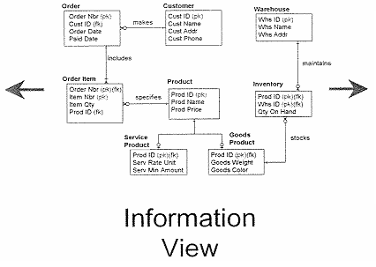


User Views
The business view represents many different perspectives of the same data.
The technical view represents the physical view of the data where there may be many databases and files for the same data.
Therefore the information view/user view (i.e. data model) consolidates both the business view and technical view into one representation.

Slide 7
Types of Data Models
Conceptual
Business Users
Logical
Designers
Physical
Implementers
Multiple levels of abstraction, ranging from very general to highly specific.

Slide 8
Conceptual Data Model
A Conceptual data model is :
Semantic layer representing business view
Database and technology, organization independent
High level model depicting core subject areas and key entities
in each subject area

Slide 9
Logical Data Model
A logical data model (LDM) is:
Conceptual
Database, technology and organization independent
A non-redundant single representation for all user views
A picture that captures and communicates the information and business rules of the organization

Slide 10
Defining Business Rule
The structure and relationships (formal or informal) of the policies, business practices and guidelines which govern the way an enterprise conducts business.
Business analysis and application development require a clear, consistent and unambiguous understanding of the underlying business rules of the enterprises.
Example:
A premium payment is applied to one policy
A policy is issued by one insurance company

Slide 11
Physical Data Model
A Physical Data Model (PDM) is:
Physically implemented as a database
Targeted for a specific database platform such as oracle, Sybase, ingress, Informix, DB2 etc
An implementation of some or all of the business rules specified in the LDM
Geared for performance and may consist of redundant data
The main focus of development should be the logical data model.

Slide 12
Data Model Benefits
A Promotes project success
Quality business requirements definition
Simplifies complex systems
Facilitates effective communication
Simplifies complex systems
Facilitates effective change management
Provides stability to applications
A Model that captures and communicates business rules can be used for virtually any business need.
The act of modeling provides a focused way for business and information technology stakeholders to analyze and define critical business impacts of any project.

Slide 13
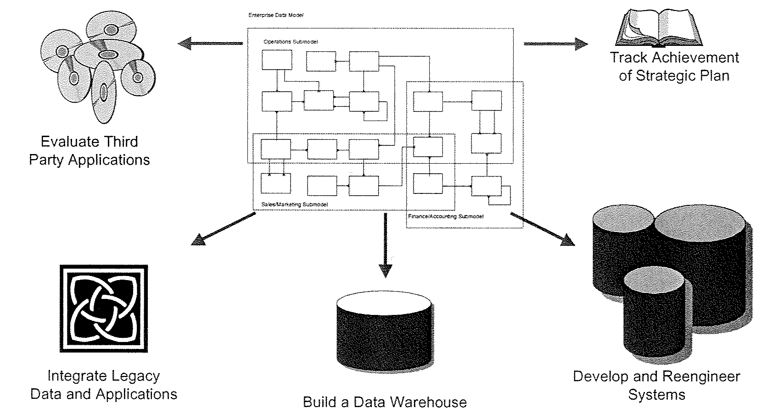
Uses of Data Model
Data model can be used to achieve many different goals.
The classical use of a data model is to develop a database with a systems development or reengineering project.
It is also an integral part of data warehouse development.

Slide 14
Data Modeling – Terms & Concepts
Entity type, Business Metadata, primary Key

Slide 15
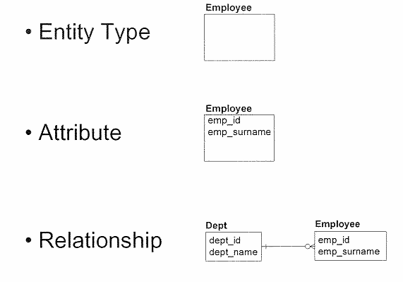
Basic Constructs
A data model is composed of three basic constructs: entity types, attributes and relationships.

Slide 16
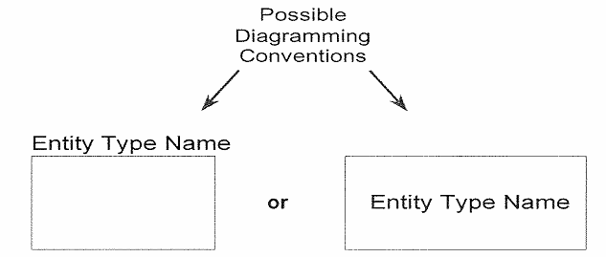
Entity Type
An entity type is a type of person, place, thing, concept or event which an organization must manage and for which data is stored.
Common examples of entity types include those of customer, employee, location, order, vendor, part etc.
Other common examples of entity types include those that categorize other entity types, for example employee type, part type etc.

Slide 17
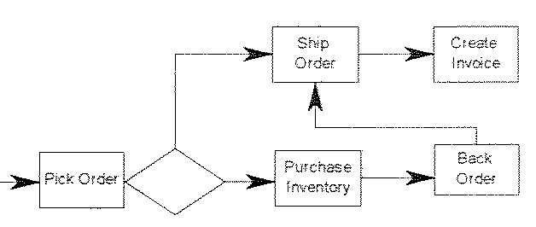
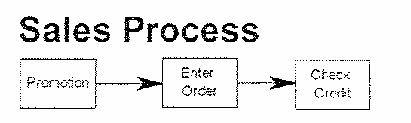
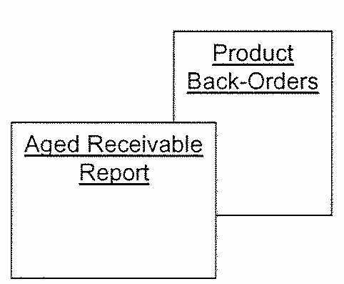
Common Mistakes in Entity Type Selection
Processes:
Reports:
A data model should not contain process-oriented requirements (e.g. order entry process, credit approval process , etc.).
A data model should be able to produces reports, but report itself does not need to be captured in the data model.

Slide 18
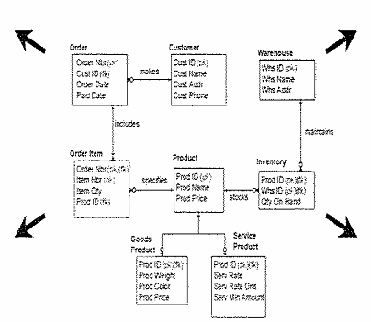
Business Metadata
Name
Sample Occurrences
Business Rules
Description
Meta-data is data about data that is used to defined and describe all modeling constructs (i.e. entity types, attributes, relationships).
It is extremely important to capture detailed meta-data throughout the entire modeling effort.

Slide 19
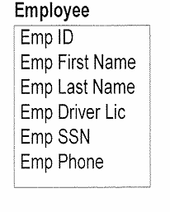
Attribute – Definition & Example
An attribute is a characteristic that describes an entity type and is typically expressed as a noun qualified by an adjective.
Attributes are listed inside the entity type to which they belong.

Slide 20
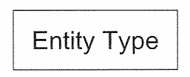
Metadata for Entity Type
Name
Description
Use concise, non-technical description (forms the basis for establishing group consensus and used for ongoing reference
Use examples for clarification
Volume and frequency of change
Specify expected data volume
Specify how often
Occurrences change, get added, deleted
Aliases
Specify “also known as” … very prevalent in large organizations. Example: Location, Unit etc.

Slide 21
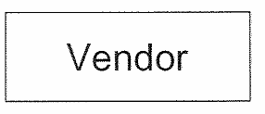
Entity Type Metadata Example
Name : Vendor
Description : A U.S. or domestic corporation that we have reviewed with respect to their qualifications for providing products to our company. Vendors are rated based on price, quality, delivery performance and financial stability.
Volume : 100
Frequency of Change : Monthly
Alias : Supplier
Notes:
Now we are in the second part of the module. - Data Modeling –Terms & Concepts
As you go through the development of the data model you will encounter the jargon used in it.
We have encountered Entity Types, relations, keys etc before this. Let us understand what each means and what are the concepts behind it.
Some more concepts are covered in Part 3 of this series.
© 2009 Wipro Ltd – Internal & Restricted
‹#›

Slide 22
Attribute Metadata Example
Name : Employee ID
Description : In house assigned number used to identify all of our employees
Optionality : Mandatory
Data type : Integer
Length of data : 6
Domain : Range = 100000 to 999000
Rules : Must be unique
Alias : badge number, work number
Sample : 345203
Metadata for an attribute should include at least the name, description, Optionality, data type and length, domain, value rules, alias and sample occurrence
A data model may include more meta data than this but not less
All of the metadata helps to clearly define an attribute
Notes:
A data model is composed of three basic constructs: entity types, attributes and relationships.
Basically a business process is defined in terms of entities, attributes and relationships in data model.
First the Entity types and its attributes are determined. Some attributes become part of primary key.
Then relationships are established among entity sets. In some cases like many to many relationship it is further broken down into two one to many relations with creation of one more entity set. The new entity set is known as weak entity set as it has no existence of itself. The entity sets from which it is derived are known as strong entity sets as they have there own independent existence. Some attributes define the property of relationship in better way, so they are passed to the new entity set. More on this will be covered in Advanced data modeling.
In this slide an entity type ‘Employee’ is considered which has attributes as emp_id and emp_surname.
Also a relationship between Dept and Employee is shown.

Slide 23
Module Summary
Congratulations! You have now completed the 2nd part of the module “Data Modeling concepts”
You should now be able
What stages a data model goes through
What is Entity Type, Attribute
What is Metadata
Notes:
Let us start with an outline of data modeling.
The data modeling is carried out in phases, namely-conceptual, logical and physical. This phased or layered approach has immense benefits.
As the three layers are relatively independent of each other, multiple database vendors find it highly portable . The logical model can be implemented on various databases for e.g. Oracle, Sybase, DB2 etc, where it is converted to physical model. The architecture of different databases can be different but the data model is same. The data model is not bound to any database vendors. The company thus gains benefit from this, and can choose from multiple databases based upon cost, ease of use, maintenance benefits. For e.g. In the same company one business process can run on Oracle, while other on Sybase.
We will cover each layer in more details including Data Model Benefits and Use of Data Model.
© 2009 Wipro Ltd – Internal & Restricted
‹#›

Slide 24
Quiz
Notes:
A data model is an Information view/User view which consolidates business data to form a repository.
The business view represents many different perspectives of the same data. For example: suppose an organization has business location in home country and in foreign countries. The customer of a particular foreign country is local to the sales department of the organization located in same foreign country. But for the sales dept in home country, the customer is not local.
The technical view represents the physical view of the data. It shows how the data model is implemented in a particular database for e.g. Oracle, Sybase etc. So there can be multiple physical implementation of business view.
The information view consolidates both the business view and technical view into one representation.
The consolidation of technical view and business view, gives easy representation of business process for the combined business and technical people. It integrates right from the business process till data storage and its retrieval.
© 2009 Wipro Ltd – Internal & Restricted
‹#›

Slide 25
Question 1
1. Which is not a valid Data Model type:
Conceptual Model
Logical Model
Business Model
Physical Model

Slide 26
Question 1
1. Which is not a valid Data Model type:
Conceptual Model
Logical Model
Business Model
Physical Model
Answer: C

Slide 27
Question 2
2. Which statement is wrong about Logical Data Model
It is derived from conceptual model
It is database dependent
It is non-redundant single representation for all user views
It is picture that captures and communicates the information and business rules of the organization

Slide 28
Question 2
2. Which statement is wrong about Logical Data Model
It is derived from conceptual model
It is database dependent
It is non-redundant single representation for all user views
It is picture that captures and communicates the information and business rules of the organization
Answer: B

Slide 29
Question 3
3. Which is not a correct entity type
Customer
Employee
Order process
Department

Slide 30
Question 3
3. Which is not a correct entity type
Customer
Employee
Order process
Department
Answer: C

Slide 31
Question 4
4. Which is not the correct statement about an attribute
Attribute can be null
Attribute can have single value
Attribute can have multiple value
Attribute can defined without data type
Notes:
This module has 2 Lessons.
Data Modeling Overview and Data Modeling- Terms and Concepts.
© 2009 Wipro Ltd – Internal & Restricted
‹#›

Slide 32
Question 4
4. Which is not the correct statement about an attribute
Attribute can be null
Attribute can have single value
Attribute can have multiple value
Attribute can defined without data type
Answer: D

Slide 33
Question 5
5. Identify the incorrect statement from the following
Logical Model is derived from Conceptual Model
Physical Model is derived from Conceptual Model
Logical Model is database independent
Physical Model is derived from Logical Model

Slide 34
Question 5
5. Identify the incorrect statement from the following
Logical Model is derived from Conceptual Model
Physical Model is derived from Conceptual Model
Logical Model is database independent
Physical Model is derived from Logical Model
Answer: B

Slide 35
References
Publications
Courses
Course structure was conceptualized from Business Data Modeling training course offered by Inteq Group
Fundamentals of Database Systems by R Elmasri, S Navathe, Publisher - Addison Wesley
DWH Concepts
URL’s
Training Programs
www.learndatamodeling.com
www.agiledata.org
Wipro Data warehousing Training Material

Slide 36
Thank You
Anand Kumar
Project lead
Anand.akumar@wipro.com

